Slide 1
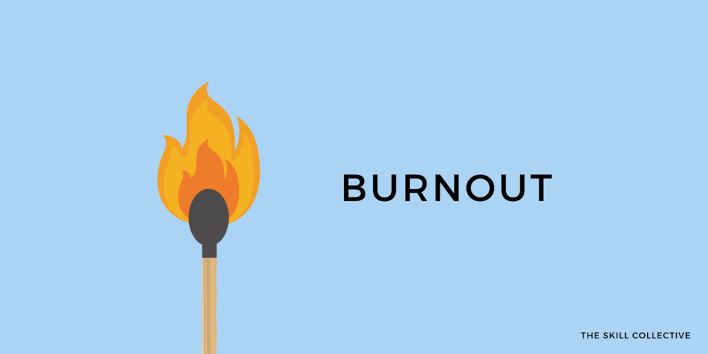
Personal & Sustainable Strategies to Prevent Work-Related Burnout
Major: Applied Computing, Minor: Consciousness & Creativity
By: Gabriel Smith-Dalrymple
Introduction
Process
Results
Conclusion
Background
Design
University of Washington | Bothell

Slide 2
